Slide 1

Phoneme-Grapheme
Correspondences
Updated July 2024

Slide 2



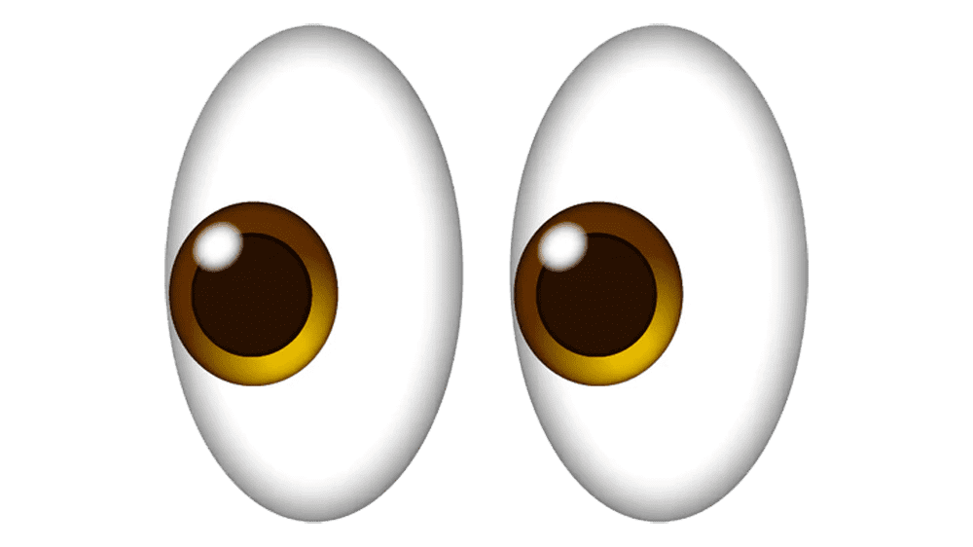
Phonemes vs. Graphemes
A phoneme is the smallest unit of spoken sound and is often the one thing that distinguishes one word from another (e.g., what you hear in the sound /k/)
A grapheme is the smallest unit of written language, what you see (e.g., the sound /k/ can be written for you to see 5 ways: c, k, ck, qu, ch)

Slide 3
Fundamental reading skills involve being able to take words apart and put them back together again to create new words.
Understanding the connection between what words sound like (phonemes) and what they are represented by in writing (graphemes) is a vital skill for understanding how to read print.

Slide 4
Phoneme-Grapheme Correspondences: Activity
On the following slides you will hear the sounds of 45 phonemes and see their corresponding graphemes.
Please note that the graphemes for the phonemes shown are the most common spellings, but this presentation does not include all possible graphemes for each phoneme.
To begin, simply start the PowerPoint and you will hear each corresponding sound.

Slide 5
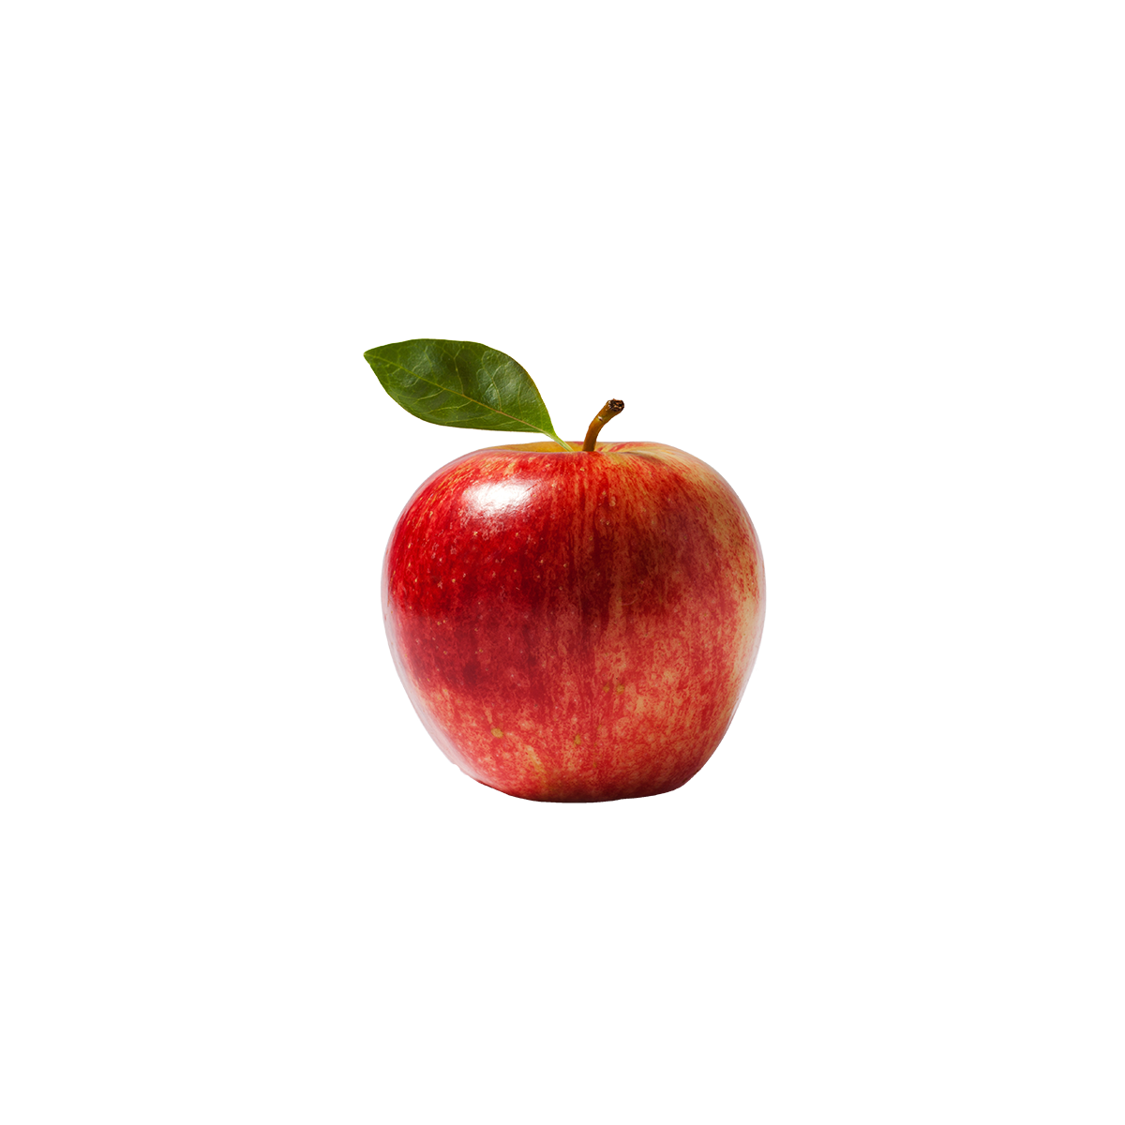

a

Slide 6

b

Slide 7
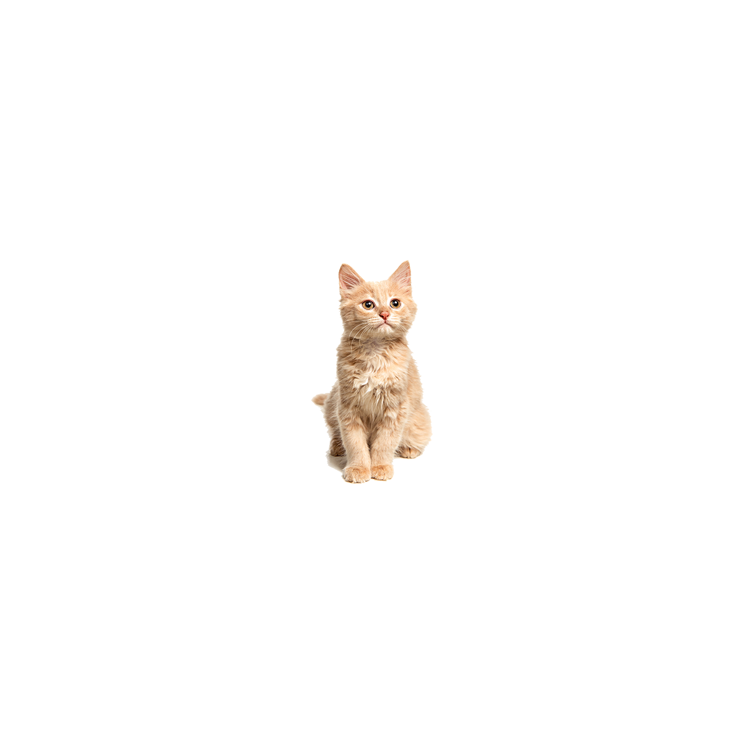
c
k
_ck

Slide 8

d
_ed

Slide 9

e

Slide 10

f
_ff
_gh
_ph

Slide 11
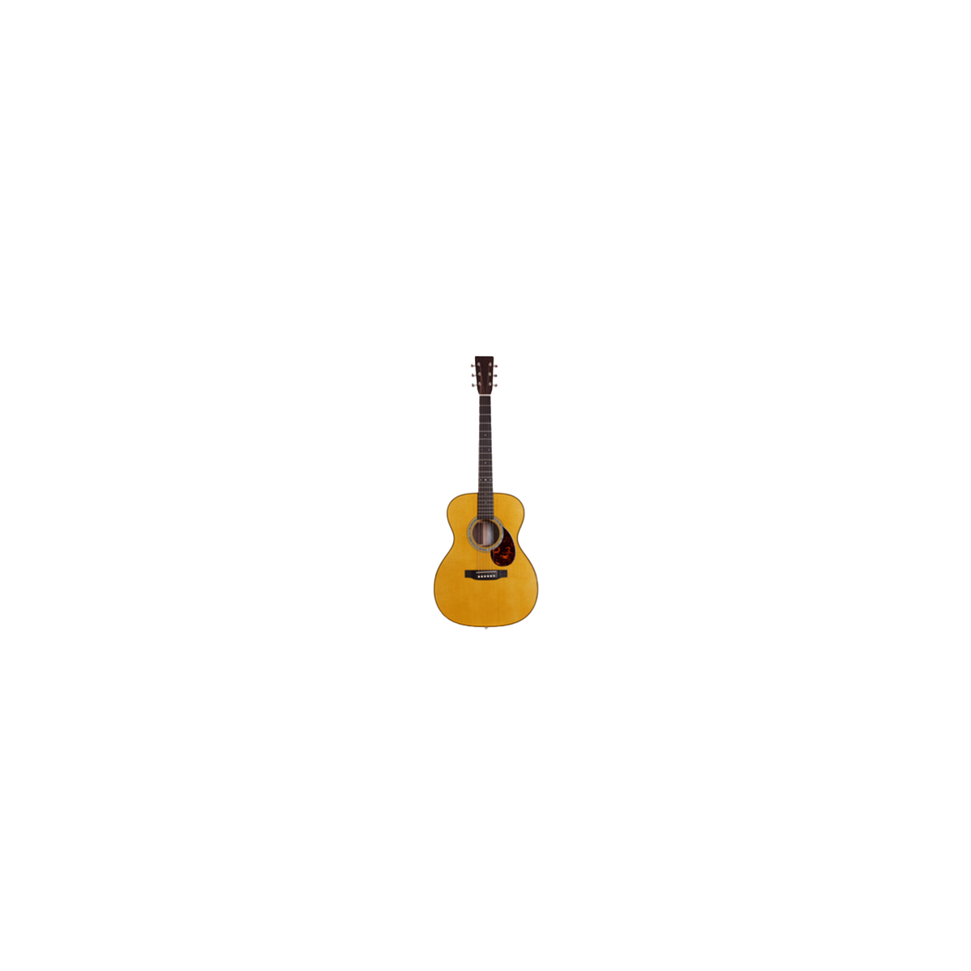
g
_gg
gh

Slide 12

h
wh

Slide 13

i

Slide 14

j
_dge
_ge

Slide 15

k
c
_ck

Slide 16

l
_ll

Slide 17

m
_mb
_mn

Slide 18

n
kn_
gn_

Slide 19

o

Slide 20

p

Slide 21
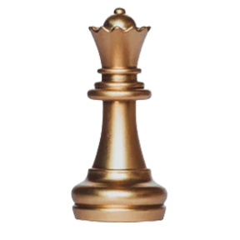
qu

Slide 22

r
wr

Slide 23

s
_ss
sc_
ps_

Slide 24

t
_tt
_ed

Slide 25

u

Slide 26
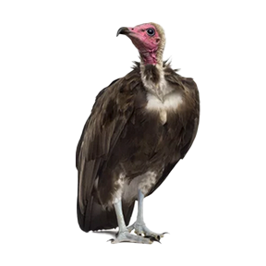
v

Slide 27
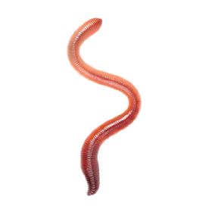
w

Slide 28
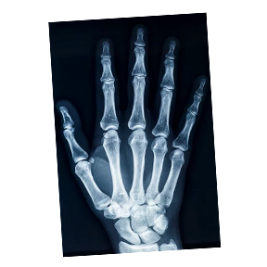
x
_cks

Slide 29

y

Slide 30
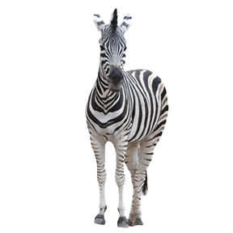
z
_zz
s
x

Slide 31
Long Vowels
When the vowel says its name.

Slide 32
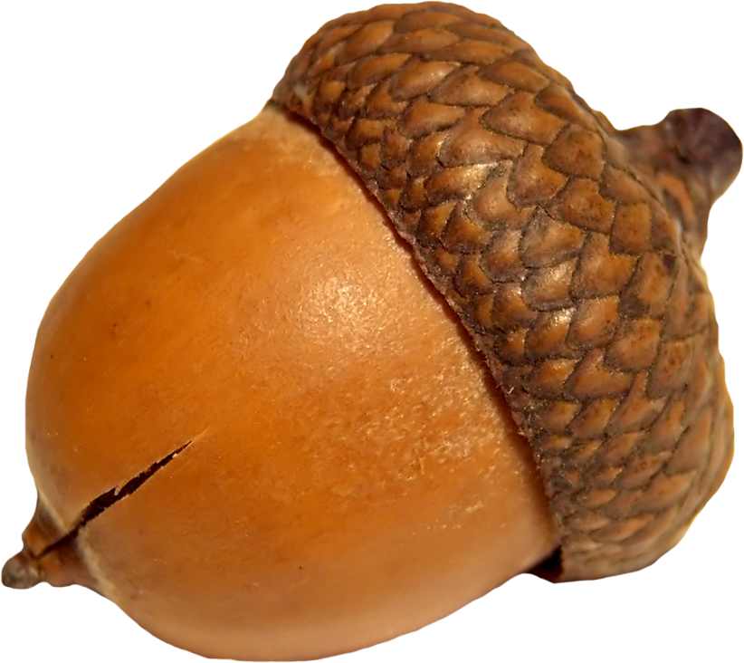
a_e
ai
ay
eigh

Slide 33

ee
e_e
ea
_y
_ie_

Slide 34
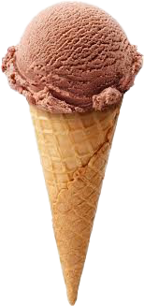
i_e
ie
_y
igh

Slide 35

o_e
oa
oe
ow
o_

Slide 36
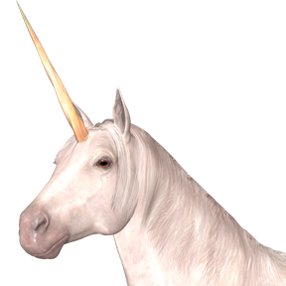
u_e
ew

Slide 37
Diagraphs
A combination of two or more letters that work together to make a single sound.

Slide 38

th
*like “thumb”

Slide 39

th
*like “feather”

Slide 40
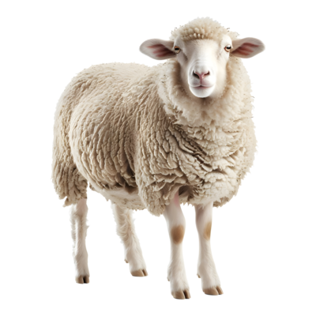
sh

Slide 41
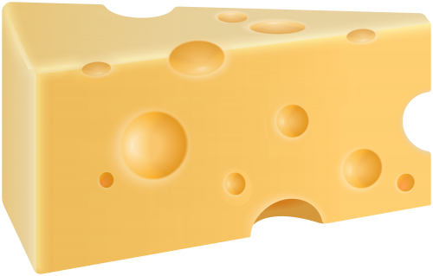
ch

Slide 42
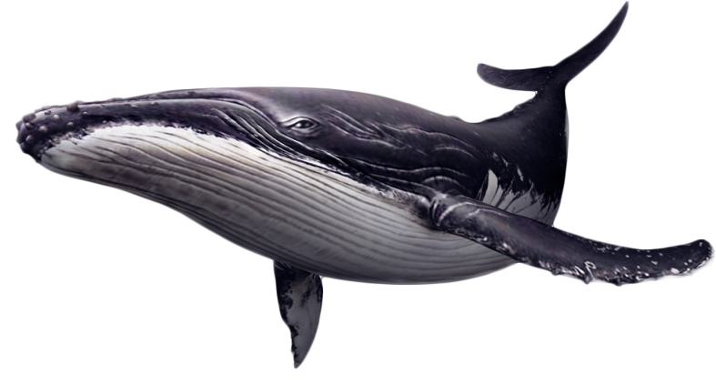
wh

Slide 43
Diphthongs
A sound composed of two vowel sounds, causing your mouth to change positions as you say that sound.

Slide 44
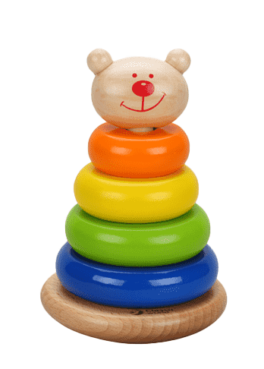
oi
oy

Slide 45
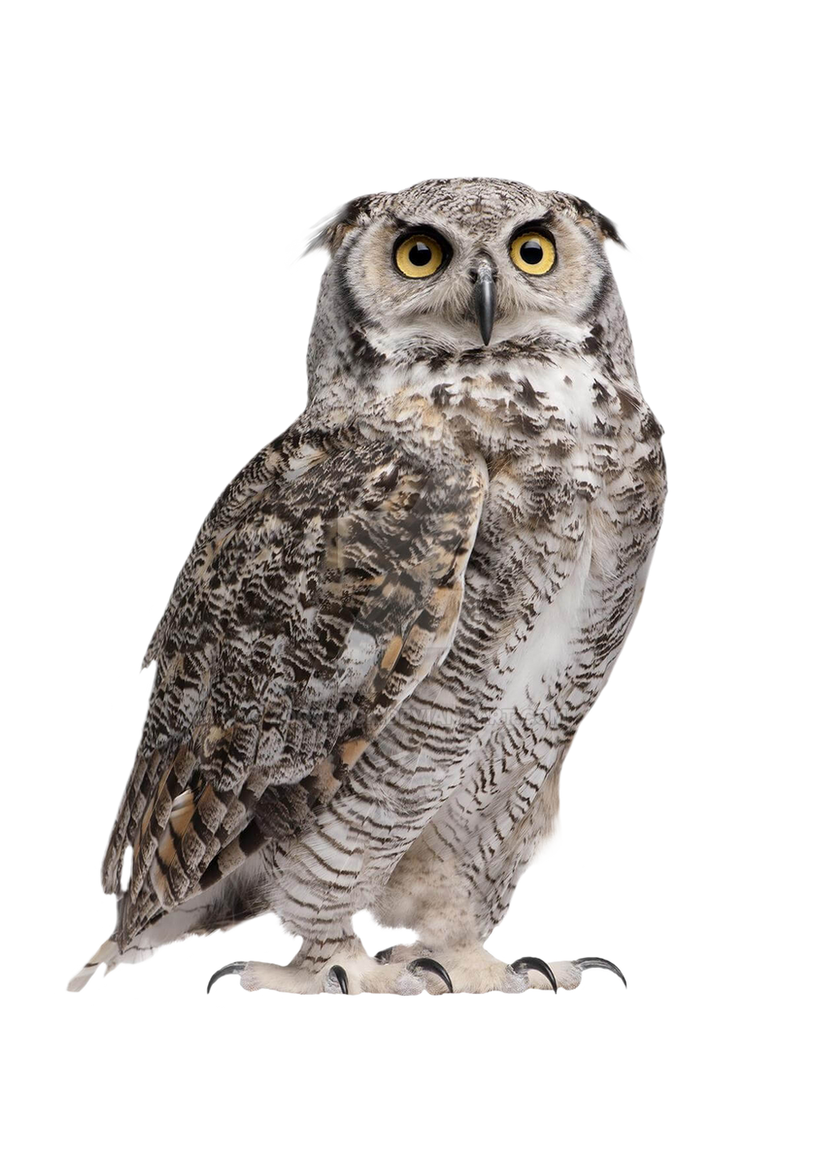
ow
ou

Slide 46

oo
u_e
ue
ew

Slide 47
oo
u

Slide 48
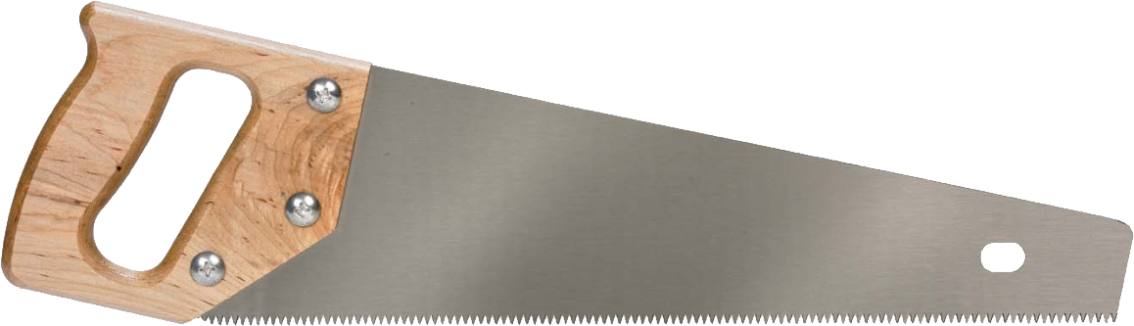
aw
au
ough

Slide 49
R-Controlled Vowels
A vowel immediately followed by the letter 'r' and can no longer be pronounced as a long or short vowel.

Slide 50
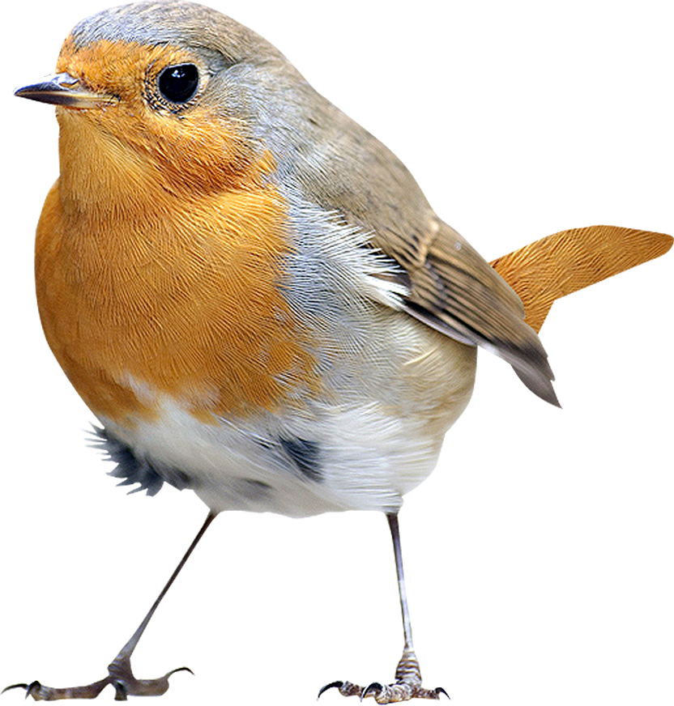
ir
er
ur
ear_

Slide 51
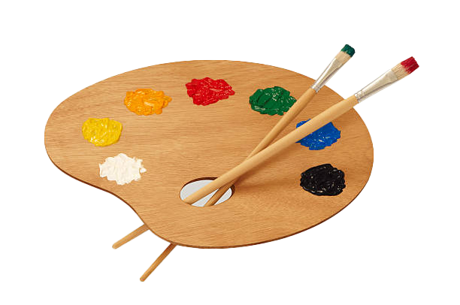
ar

Slide 52
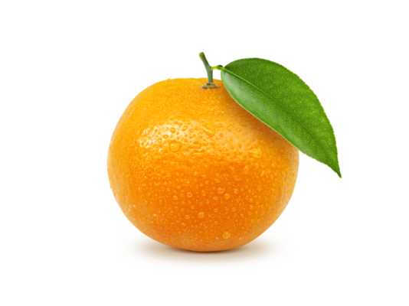
or
ore

Slide 53

air
are
_ear

Slide 54
Additional Sounds

Slide 55

/zh/
*s or z

Slide 56
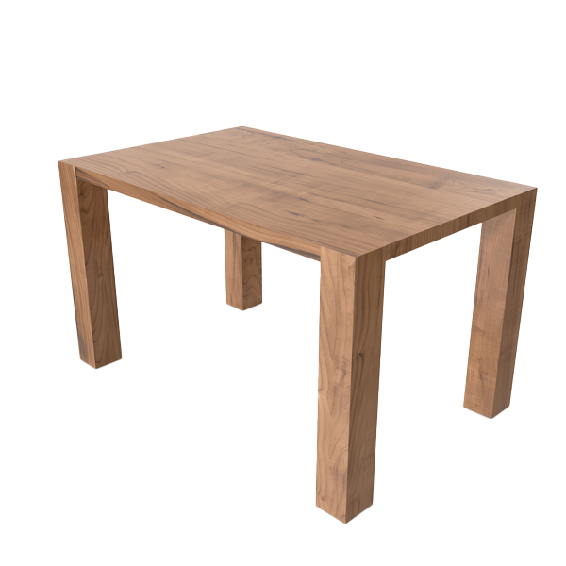
_le

Slide 57
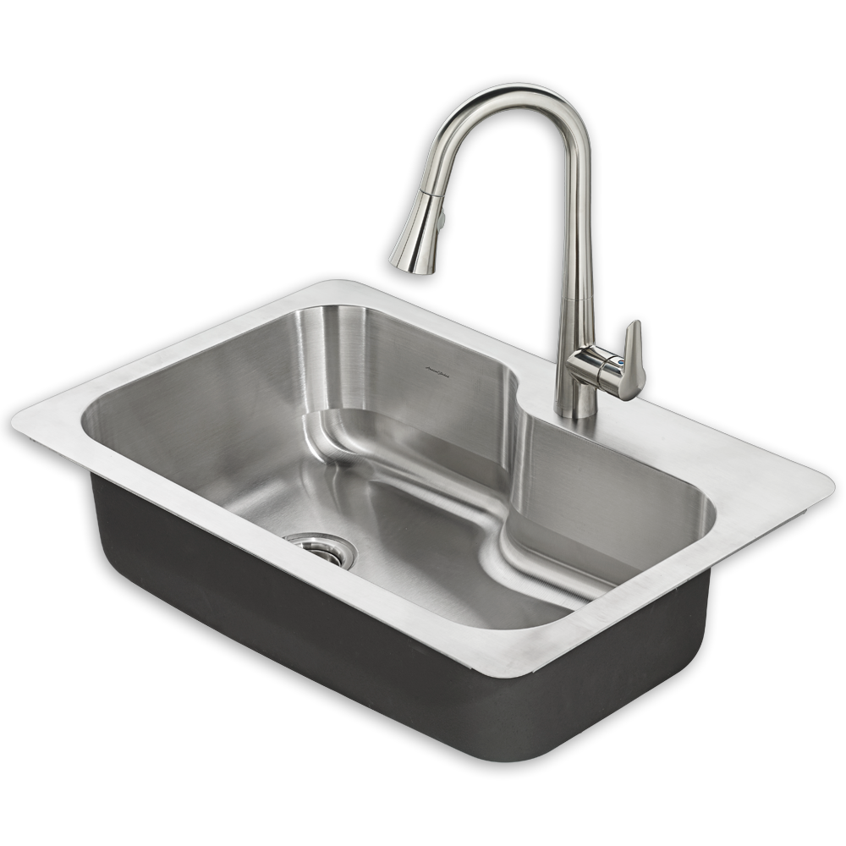
_ng
_nk

